Slide 1




Validation
Simulations
4/16/21
Isabella Dula, Sarah Yun
Finite Difference Parameter Selection
Parameter: | Value: | Notes:
Spatial res: dx=dy | 10^-4 m | <electrode size (.25 mm (x) x .035 mm (y)), dust particle size (100 um)
Time step: dt | 3.33*10^-13 s | Chose to match S_c=1
Stability (S_c=c*dt/dx, Courant Number) | 1
Total spatial domain (X) | .25 m x .25 m | x-domain size matches width of panel, y-domain matches x-domain for simplicity of applying stability parameter
nx (matrix size/number of spatial steps) | 2500 | =X/dx
Total time domain (T) | .1 s | Based off of single period of panel frequency
nt (Number of time steps over which to iterate) | 3*10^13 | = T/dt
Indicate computationally intensive simulation

Slide 2
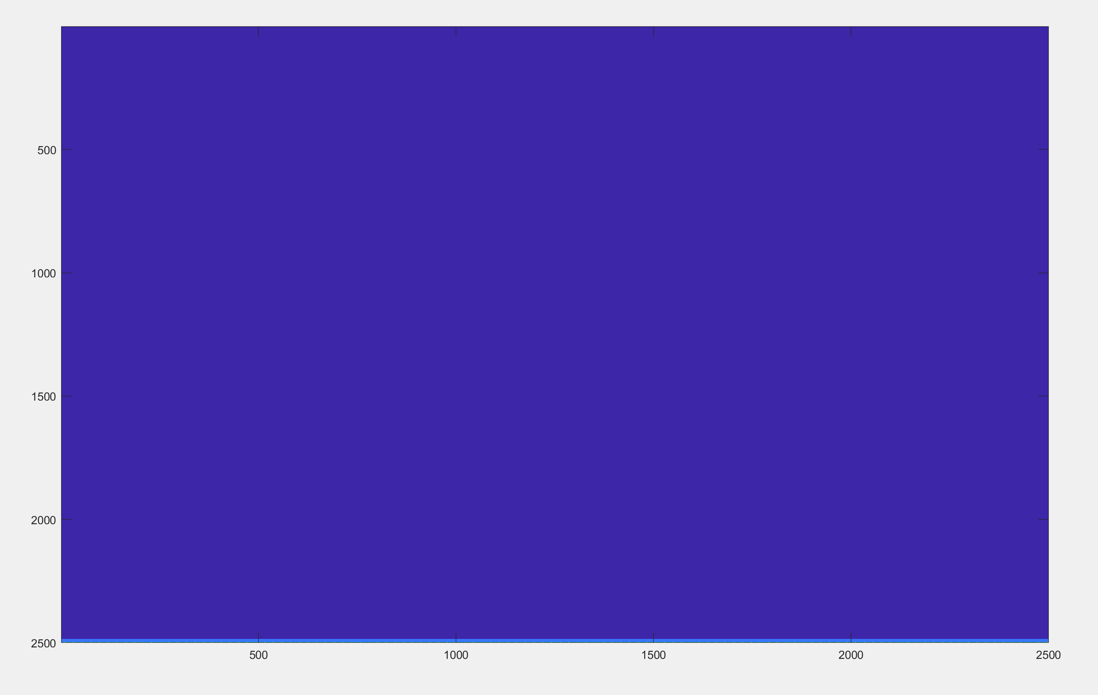
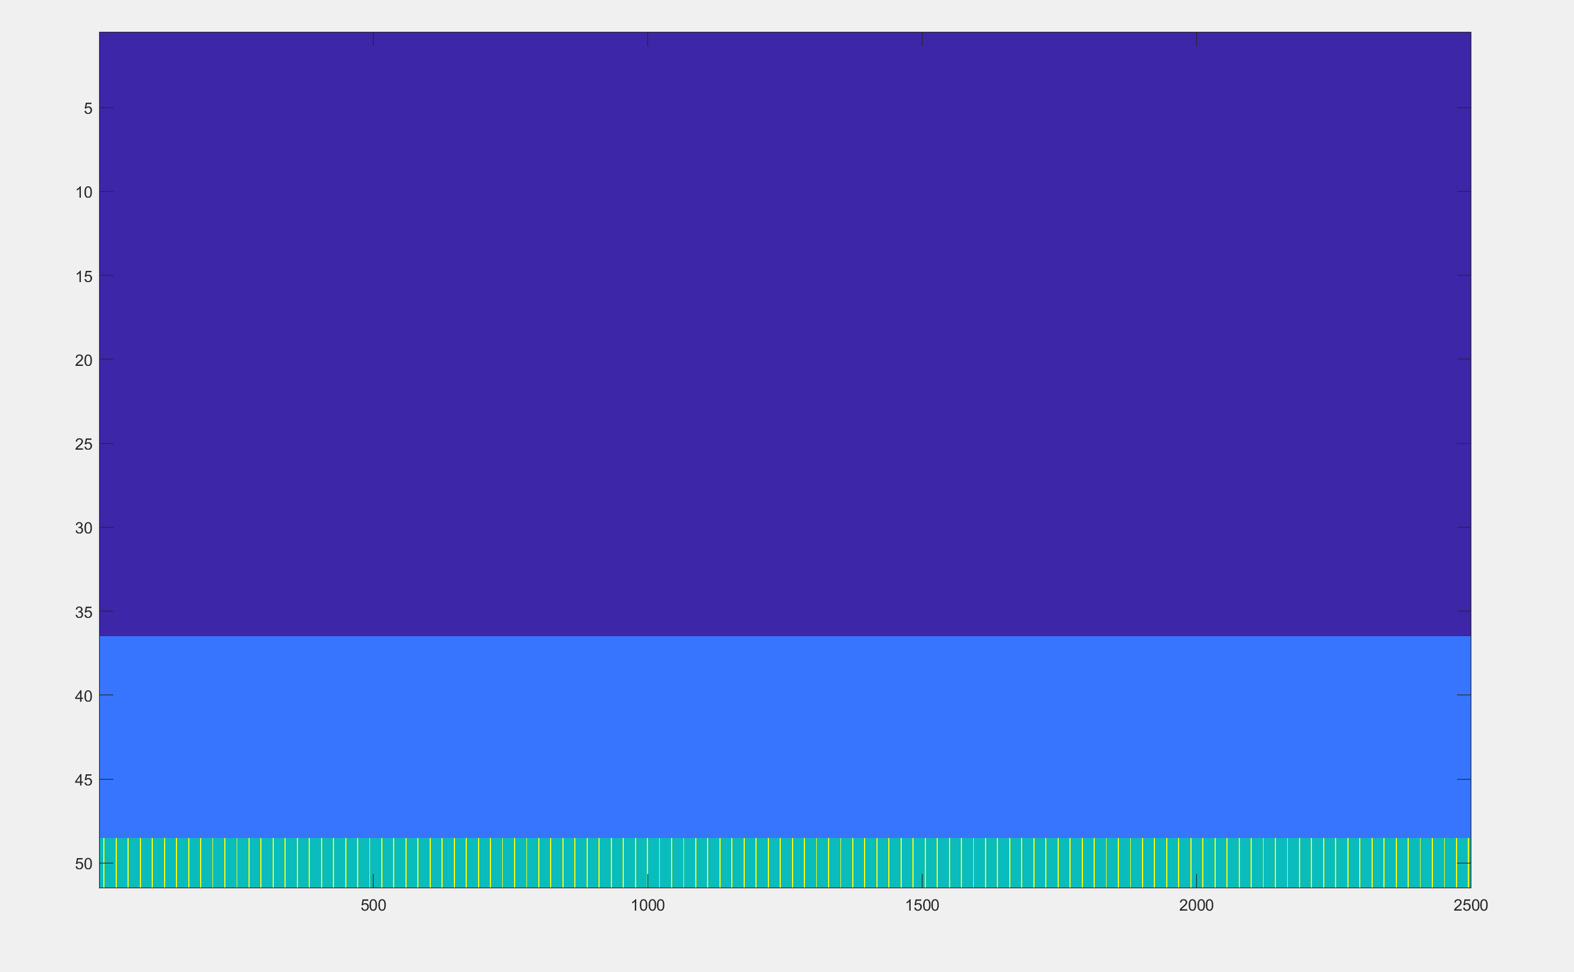
Validation
Simulations
4/16/21
Isabella Dula, Sarah Yun
Domain Mapping and Class Organization
Full Domain
.25 m
- Kapton
- Electrodes
- Alumina
- Vacuum
- Considering creating a Node class with these types as attributes vs creating a separate class for each type
Panel Closeup
Vacuum
Kapton + Electrodes
Alumina
.25 m

Slide 3
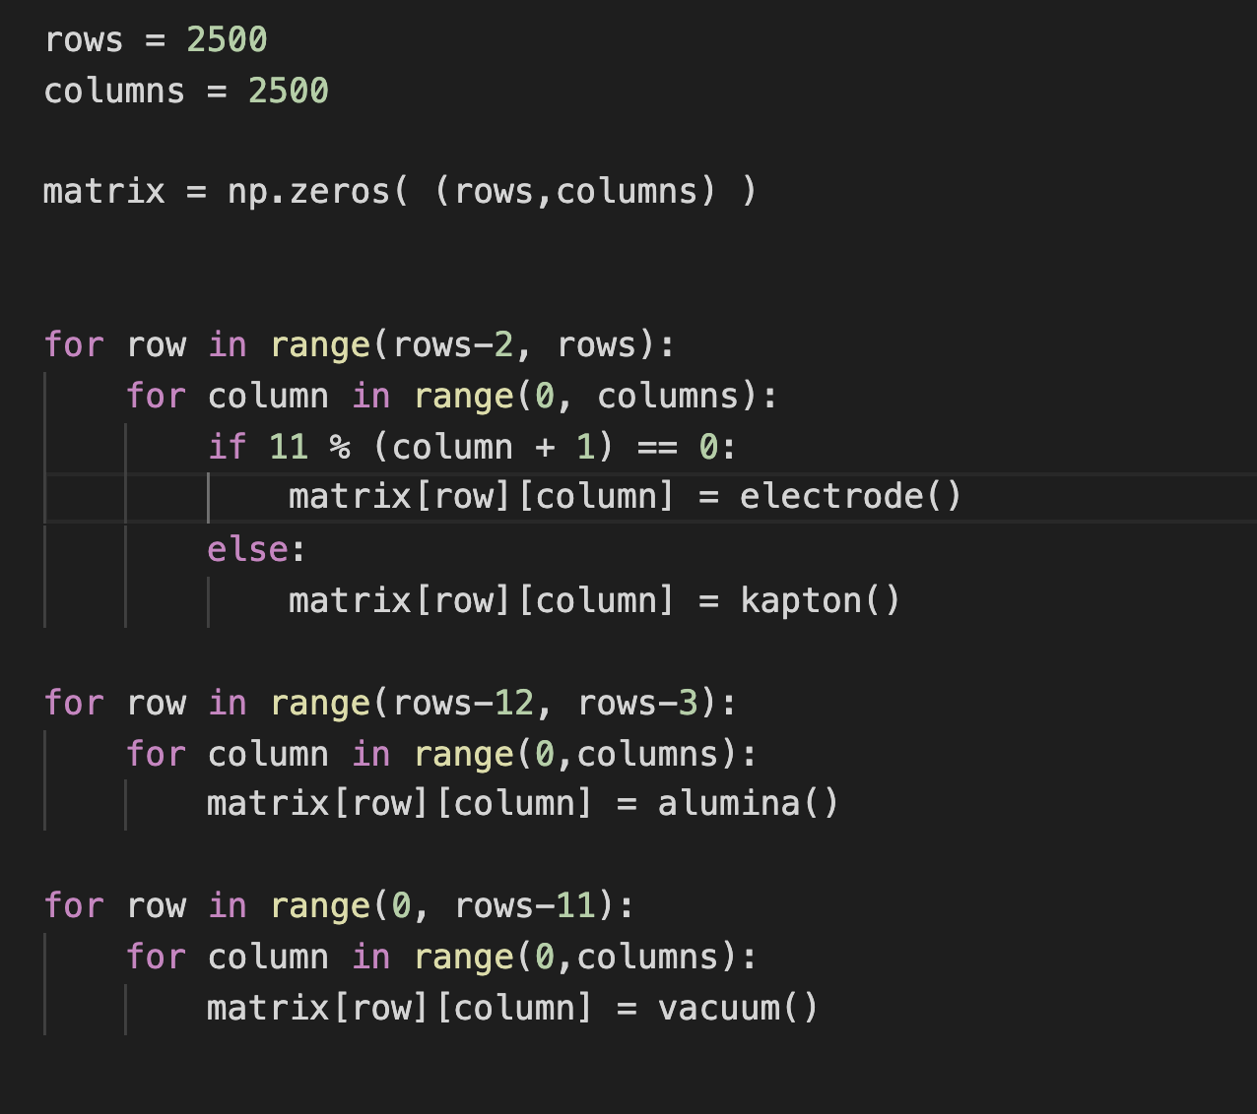
Validation
Simulations
4/16/21
Isabella Dula, Sarah Yun
Domain Mapping and Class Organization
Row of 2500 nodes, column of 2500 nodes
First, we create a blank matrix of zeros of our given size
Electrodes and Kapton placed in the last 2 rows
Alumina placed in next 10 rows
Vaccuum placed everywhere else
Vacuum
Kapton + Electrodes
Alumina

Slide 4
Validation
Simulations
4/16/21
Isabella Dula, Sarah Yun
Finite Difference Time Domain Iteration Pseudocode
Initialize Electric Field Domain
E(t=0)=0; H(t=0)=0
Set initial electrode charges
Iterate Maxwells Equation
Update electrode charges
Update finite difference equations (can’t fit here)
Apply Boundary Conditions
PEC Boundary Condition:
2nd order absorbing boundary conditions:
if E(i,j) = electron; E(i,j) = 0
E(boundary, t=n+1) = E(pseudonodes outside boundary, t=n) + E(boundary, t=n)
Charge(t) = scipy.square(2*pi*10); evaluate at time step
Constants evaluated at point; e.g. updating electric field in alumina uses dielectric constant of alumina

